Slide 1

MALIGNANT COMMENT CLASSIFIER
Submitted By :
VIKAS MISHRA

Slide 2
Business Problem Framing
Problem Statement :
The proliferation of social media enables people to express their opinions widely online. However, at the same time, this has resulted in the emergence of conflict and hate, making online environments uninviting for users. Although researchers have found that hate is a problem across multiple platforms, there is a lack of models for online hate detection.
Online hate, described as abusive language, aggression, cyberbullying, hatefulness and many others has been identified as a major threat on online social media platforms. Social media platforms are the most prominent grounds for such toxic behaviour.
There has been a remarkable increase in the cases of cyberbullying and trolls on various social media platforms. Many celebrities and influences are facing backlashes from people and have to come across hateful and offensive comments. This can take a toll on anyone and affect them mentally leading to depression, mental illness, self-hatred and suicidal thoughts.
Internet comments are bastions of hatred and vitriol. While online anonymity has provided a new outlet for aggression and hate speech, machine learning can be used to fight it. The problem we sought to solve was the tagging of internet comments that are aggressive towards other users. This means that insults to third parties such as celebrities will be tagged as unoffensive, but “u are an idiot” is clearly offensive.
Our goal is to build a prototype of online hate and abuse comment classifier which can used to classify hate and offensive comments so that it can be controlled and restricted from spreading hatred and cyberbullying.
The objective of the problem is to pass target column ‘comment text’ into various ML Algo to predict the comment falls into which classified columns (['malignant', 'highly_malignant', 'rude', 'threat','abuse', 'loathe']).

Slide 3
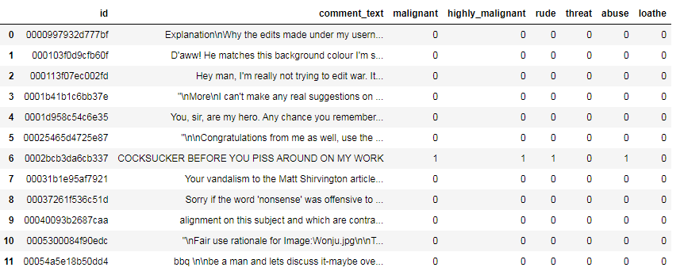
Dataset Variables Information:
Dataset Variable’s Information :
The data set includes:
Malignant: It is the Label column, which includes values 0 and 1, denoting if the comment is malignant or not.
Highly Malignant: It denotes comments that are highly malignant and hurtful.
Rude: It denotes comments that are very rude and offensive.
Threat: It contains indication of the comments that are giving any threat to someone. Abuse: It is for comments that are abusive in nature.
Loathe: It describes the comments which are hateful and loathing in nature.
ID: It includes unique Ids associated with each comment text given.
Comment text: This column contains the comments extracted from various social media platforms which will be treated as target column or target variable.

Slide 4
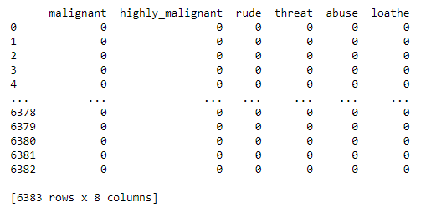
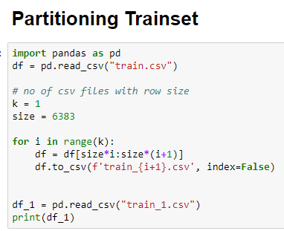

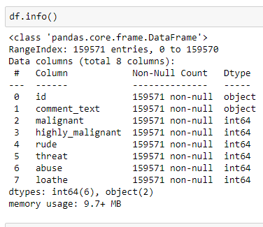
Dataset Variables Information
Dataset Variables Information:
The train & test dataset has 8 column where target column is 'comment_text' and other columns are classified column for the type of comment present in target column, the target column has offensive, threat, abusing, vulgar type of comments which are classifed as malicious, highly malicious, abuse, rude, threat and loathe accordingly those columns are present in a dataset. The main objective of problem to classify the comments as per those classified columns. further each toxic classified column is further binary classifed as '0' and '1', where the presence of '1' indicate the severity of toxic comment and the presence of '0' means there is no toxic comment present in a target column.The train and test dataset size is reduced and partioned to smaller size inorder to process the smaller size data for further analysis and model building as system was not able to process such large size data and was throwing memory error. The ID and Target Column is Object Type and remaining classification column is Int data type.

Slide 5
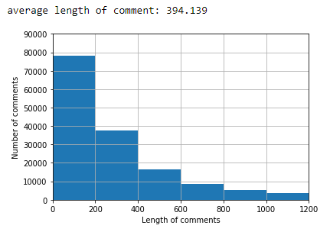
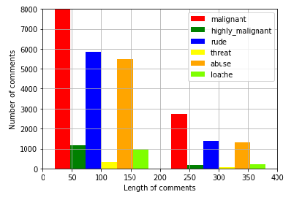
Univariate Analysis.
HISTPLOT
From the first visualization we can see legth of comment is large for the value 0-200 and thereafter it started to decrease from 200-400 and so on. the length of comment decrease for higher value, hence it is advisable to have small size of comments for processing.
From the second figure we can observe that:
-Malignant : length of comments is large for the till 50
-Highly Malignant: very less from 50-25
-rude: high from value 25 to 100, but less then malignat
-threat: very less
-abuse: high fro value 125 to 150 but less then rude and malignant.
-loathe : not so large, but greater then the value of threat.
All above length of comments is started decreasing from the value 200 till 400 as the length of comments value increases.

Slide 6
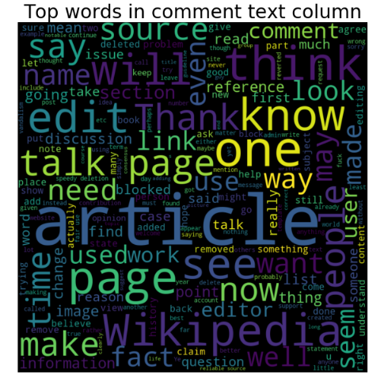
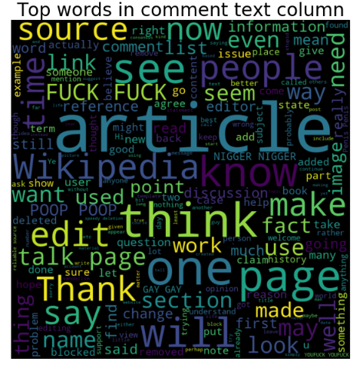
Univariate Analysis.
Wordcloud : Is a powerful way to visualise what the audience think about the Topic, which is a collection of a cluster of words occurring more frequently. The bigger and bolder the words the words appears, the more often it is voted by the audience. Trainset : From partitioned train set we can see following(article, Wikipedia, known, One etc) words is most frequently occurred.
Testset : And from partitioned testset following words is most frequently occurred (article, think, source, Thank, page etc.)
TRAINING SET WORDCLOUD
TESTSET WORDCLOUD

Slide 7
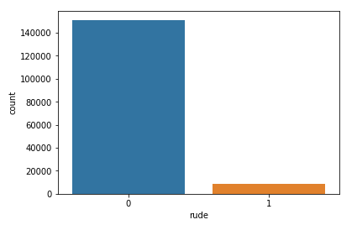
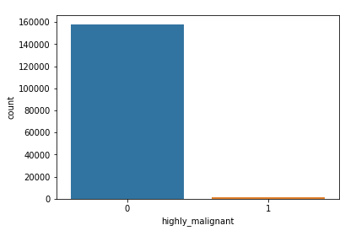
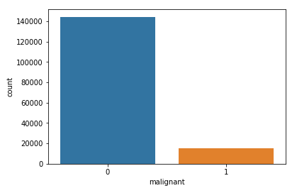

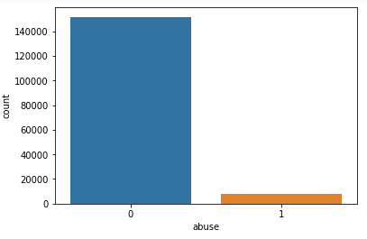
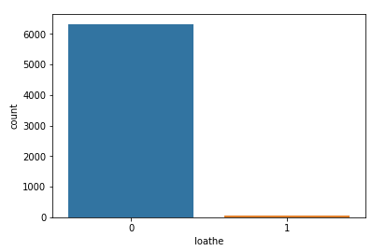
Univariate Analysis.
The dataset has target column and binary labelled multiclass column where the severity of toxic comments is classified as malignant, highly malignant etc as shown below, these toxic columns is further binary classified as 0 and 1 where 1 indicate the comment is toxic and falls into one of the severity of toxic class below.
Further With the help of countplot we can see all the toxic multiclass columns the binary class is highly imbalanced and because of this we cannot trust only on accuracy and AUC score metric for selecting the best model, Hence hamming and loss loss metric is also included for analysis which will correctly help to select the best model based on analysis of all the metrics.

Slide 8
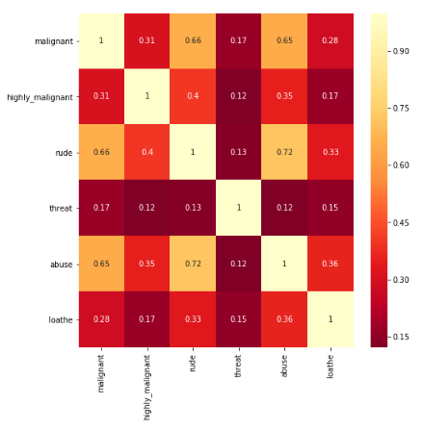
Bivariate Analysis
The trainset is separated into X & y, where X is a target column 'comment_text' and y dataset contains toxic multiclass columns as shown below in corr plot.
where we can see :
- malignant shows positive correlation with abuse and rude column.
- rude shows positive correlation with abuse and malignant.
- abuse shows positive correlation with rude and malignant.

Slide 9
Data Preprocessing : NLP Data Cleaning
The target column comment text needs to be cleaned for the words which are not relevant and must be removed for further analysis and model building, hence below steps are taken to clean the target column for further analysis and model building.
1.Missing Value : The train and test set do no have missing values.
2. Stopwords : Stop words are those words that are frequently used in both written and verbal communication and thereby do not have either a positive/negative impact on our statement and also do not convey any useful meaning and hence can be directly removed.
3. Stemming : Stemming is the process of reducing a word to its stem or root format. for example three words, “branched”, “branching” and “branches”. They all can be reduced to the same word “branch”. After all, all the three convey the same idea of something separating into multiple paths or branches. Again, this helps reduce complexity while retaining the essence of meaning carried by these three words.This helps in achieving the training process with a better accuracy.The snowball stemmer is applied to the target column comment.text through df.apply method.
4. Word Vectorizer : TfidfVectorizer - As target column commnet_text contains text which needs to be converted into numbers to process and build the model, So TfidfVectorizer is used as one of the method to convert text into numbers. tf-idf is used to classify documents, ranking in search engine. tf: term frequency(count of the words present in document from its own vocabulary), idf: inverse document frequency(importance of the word to each document).The method addresses the fact that all words should not be weighted equally, using the weights to indicate the words that are most unique to the document, and best used to characterize it.TfidfVectorizer Transforms text to feature vectors that can be used as input to estimator. Each sentence is a vector. In each vector the numbers (weights) represent features tf-idf score, So tf-idf creates a set of its own vocabulary from the entire set of documents. Which is seen in first line of output. (for better understanding I have sorted it) where vocabulary_ Is a dictionary that converts each token (word) to feature index in the matrix, each unique token gets a feature index.

Slide 10
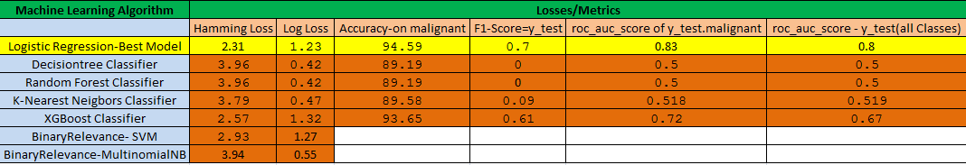
Model Summary & Performance
The following Classification Ml Algorithm used to build the model (logistic, Decisiontree, RandomForest,K-NN,XGBoost, Bianryrelevance-SVM, Binaryrelevance-MultinomialNB.)
K-fold Cross Validation and halvingGridsearchCV used to tune hyper parameter on to top above selected Algorithm( To Prevent Over-fitting and Under-fitting of the model).
As the multiclass column is highly class imbalanced where we cannot depend only on accuracy/AUC Score, hence humming & log loss is also used to select best Model.
The best model which will perform well is logistic regression as it shows low humming loss and high accuracy, AUC score on y_test_malignant as well on y-test multiclass labels.

Slide 11
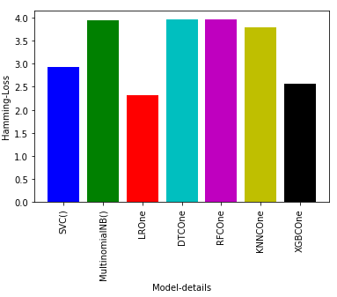
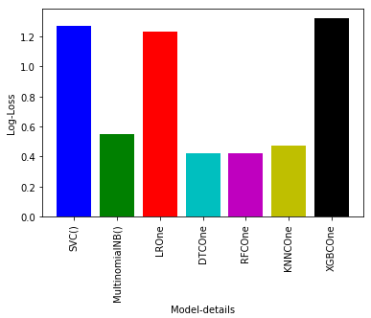
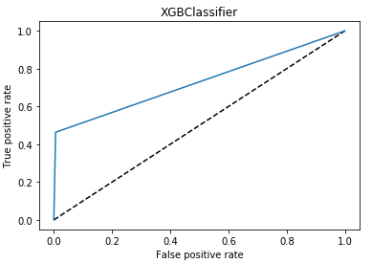
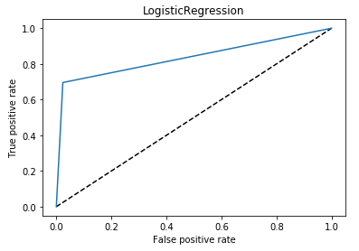
Model Summary & Performance
Humming Loss : Is the fraction of the wrong labels to the total number of labels,Since hamming loss is designed for multi class while Precision, Recall, F1-Measure are designed for the binary class, it is better to compare the last one to Accuracy Also specifically for imbalanced problems, accuracy is a problematic metric. The Hamming loss lower being better.
Log-Loss: is indicative of how close the prediction probability is to the corresponding actual/true value (0 or 1 in case of binary classification). The more the predicted probability diverges from the actual value, the higher is the log-loss value.but log-loss is still a good metric for comparing models. For any given problem, a lower log-loss value means better predictions.
So, if we compare models based only on Log Loss than DecsionTree and RandomForest Classification model shows low Log Loss Values.
The only logistic regression shows best AUC Curve & AUC Score as well as high accuracy among all followed by XGBoost Classifier.
From Further analysis we can see Logistic regression shows low humming loss and high accuracy as well AUC Score followed by XGBoost Classifier.
From Above Analysis Logistic regression will perform best among rest other ML Algorithm.
Hamming Loss
Log Loss
AUC Curve

Slide 12
Challenges Faced
Finding out and Performing EDA on Important Variables.
Processing of large value of training and test dataset.
Cleaning of text data on comment text column
Calculation of hamming and log loss and applying on all model.
Model building & Hype parameter tuning and selection of best model.

Slide 13
Overcoming Challenges:
As it was a multiclassification problem, So with the help of Countplot it was possible to detect class imbalance issue, Corr plot detect correlated variables among multiclass variables, plotting wordcloud to know most repeated word occurring in train and test set and hist plot helps to know length of comments present in a target variable 'comment_text'.
As the training and test set has large number of rows which is not easy for the system to process, Hence both train & test size reduced to 6000-7000 rows in order to analyse, process and build the model.
Stopwords, Stemming and TFID Vecotorizer is appled to target variables in order to process and clean target variables before model building..
Hamming Loss and Log Loss is also used as the problem is multilabel multiclass problem where it might be difficult to trust only on accuracy , F1 or AUC-ROC Score metrics to select the best model..
Selection of hyperparameter is done through halving- gridsearchCV along with K-Fold CV to select best param.

Slide 14
Thank You

